Slide 1

COVID-19 FACEMASK DETECTION
WITH DEEP LEARNING AND COMPUTER VISION
Under the guidance of:
Dr.A.Nirmal Kumar.
Submitted by:
T. Nagaraju (17R01A05H0)
A. Akshitha (17R01A0566)
P. Shiva Ganesh (17R01A05F8)
K. Sai Kumar (18R05A0524)

Slide 2
ABSTRACT
The corona virus COVID-19 pandemic is causing a global health crisis so the effective protection methods is wearing a face mask in public areas according to the World Health Organization (WHO). The COVID-19 pandemic forced governments across the world to impose lockdowns to prevent virus transmissions. Reports indicate that wearing facemasks while at work clearly reduces the risk of transmission. An efficient and economic approach of using AI to create a safe environment in a manufacturing setup. A hybrid model using deep and classical machine learning for face mask detection will be presented. A face mask detection dataset consists of with mask and without mask images , we are going to use OpenCV to do real-time face detection from a live stream via our webcam. We will use the dataset to build a COVID-19 face mask detector with computer vision using Python, OpenCV, and TensorFlow and Keras. Our goal is to identify whether the person on image/video stream is wearing a face mask or not with the help of computer vision and deep learning.

Slide 3
INTRODUCTION
Here we introduce a mask face detection model that is based on computer vision and deep learning. The proposed model can be integrated with surveillance cameras to impede the COVID-19 transmission by allowing the detection of people who are wearing masks not wearing face masks. The model is integration between deep learning and classical machine learning techniques with opencv, tensorflow and keras. We have used deep transfer leering for feature extractions and combined it with three classical machine learning algorithms. We introduced a comparison between them to find the most suitable algorithm that achieved the highest accuracy and consumed the least time in the process of training and detection.

Slide 4
EXISTING SYSTEM
Existing system was on convolutional neural networks, only the two features with the most variance were used to train the model. The model was set to have 2 clusters, “with mask” and “without mask”.
Changing Initial learning rate, epoch, backsize also made little difference on final values.

Slide 5
LIMITATIONS
Firstly, the access problem in GoogleColab Notebook: it did not allow the access of webcam which posed a hurdle in testing images and live video stream through Google Colab Notebook. Therefore, we had to run the code locally on the computer through which we tested the code on the live video stream
In CNN, image processing take more time, which is hard to detect the mask as this project is implemented through IP cameras and CCTV cameras which need faster image processing.

Slide 6
PROPOSED SYSTEM
The proposed system focuses on how to identify the person on image/video stream wearing face mask with the help of computer vision and deep learning algorithm by using the OpenCV, Tensor flow, Keras and PyTorch library.
Approach
Train Deep learning model (MobileNetV2)
Apply mask detector over images / live video stream

Slide 7
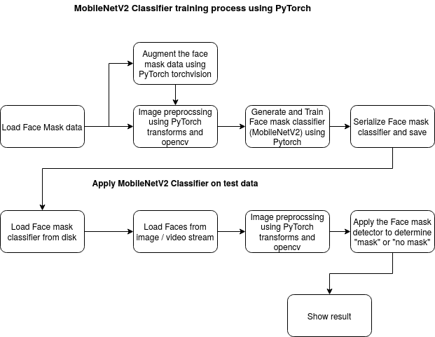
ARCHITECTURE

Slide 8
ADVANTAGES
Mobilenet used in the project is efficient and optimized CNN’s compared to the traditional Convolutional neural networks even though we get less accurate results and Mobilenet also takes lesser parameters.
This project can be equated to any USB, IP cameras, CCTV cameras to detect people without a mask, using live video feed can be implemented in web and desktop applications so that operator can see notice messages.

Slide 9
CONCLUSION
As the technology are blooming with emerging trends the availability so we have novel face mask detector which can possibly contribute to public healthcare. The architecture consists of MobileNet as the backbone it can be used for high and low computation scenarios. In order to extract more robust features, we utilize transfer learning to adopt weights from a similar task face detection, which is trained on a very large dataset. We used OpenCV, tensor flow, keras , Pytorch and CNN to detect whether people were wearing face masks or not. The models were tested with images and real-time video streams. The accuracy of the model is achieved and, the optimization of the model is a continuous process and we are building a highly accurate solution by tuning the hyper parameters. This specific model could be used as a use case for edge analytics. Furthermore, the proposed method achieves state-of-the-art results on a public face mask dataset. By the development of face mask detection we can detect if the person is wearing a face mask and allow their entry would be of great help to the society.

Slide 10
REFERENCES
[1] Haddad, J., 2020. How I Built A Face Mask Detector For COVID-19 Using Pytorch Lightning. [online]Medium. Available at: https://towardsdatascience.com/how-i-built-a-face-mask-detector-for-covid-19-using-pytorch-lightning-67eb3752fd61.
[2] Rosebrock, A., 2020. COVID-19: Face Mask Detector With Opencv, Keras/Tensorﬂow, And Deep Learning- Pyimagesearch. [online] PyImageSearch. Available at: https://www.pyimagesearch.com/2020/05/04/covid-19-face-mask-detector-with-opencv-keras-tensorﬂow-and-deep-learning/
[3] Keras code inspiration taken from https://github.com/chandrikadeb7/Face-Mask-Detection13

Slide 11
THANK YOU

